Slide 1
CS355/555
Midterm 1 Review
3/3/2025

Slide 2
Average: 89
Undergraduate average: 74
Graduate average 101

Slide 3
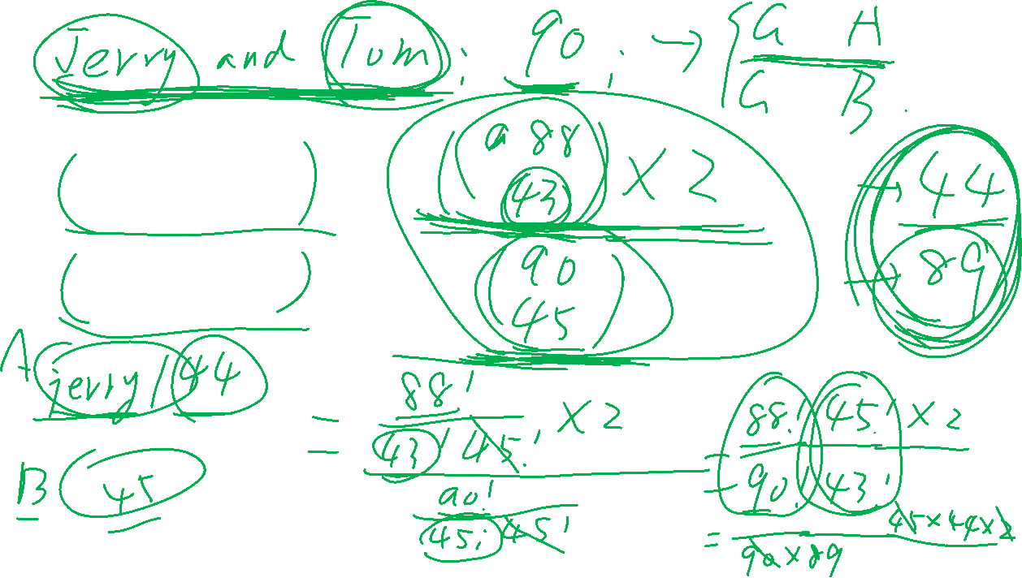

Slide 4
